Slide 1
Engendering CSR? The Ignored Role of Unpaid Care Work
Dr. Lauren McCarthy,
Copenhagen Business School, Denmark.

Slide 2
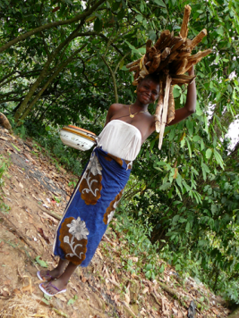
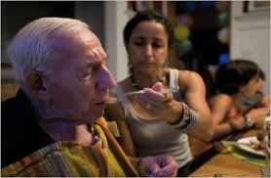
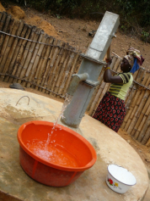
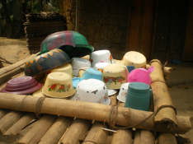
Unpaid Care Work
Women the world over perform 80% of unpaid care work (The World Bank, 2011).
This impacts on their ability to engage in paid labour, in CSR programmes, in education, training or leisure time (Carmona, 2013).
It pushes more women than men into micro-enterprises which balance home and work life (Nguyen et al., 2013)

Slide 3
Adapted from ActionAid 2013; OECD, 2010.

Slide 4
How do we tackle this?
1. Recognition of the role of women and girls in the provision of unpaid care, as well as its social and economic value.
2. Reduction in the drudgery and time burden of unpaid care, especially for women living in poverty.
3. Redistribution of unpaid care work: from women to men, and from the family to communities and the state (IDS, 2014).

Slide 5
How does CSR fare?
‘Engendered’ CSR in Cocoa production, Ghana.
Research undertaken in partnership with a British chocolate company, their Ghanaian supplier & NGO partner in 2013.
Interpretive-approach, single embedded case study. Methods involve in-depth interviews, observations, doc. Analysis, participatory visual methods.
The Gender CSR Programme involved:
The formation of ‘Women’s Groups’
The formation and training of micro-enterprises e.g. crafts; vegetable growing; soap-making.
- Encouraging women into leadership roles
Training them in leadership behaviour

Slide 6
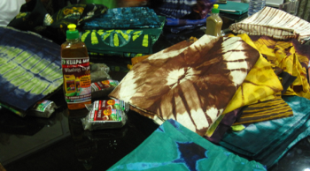
Recognition?
Women’s unpaid care roles are
unrecognised by CSR practices (and
largely by workplace practices in general) (Pearson, 2007).
The cocoa company did not include measures of women’s work on the cocoa farm before developing their programme.
Women are actually engaged in cocoa farming as much as men- so where will they have time to do the CSR programme?
Feminist economists argue for a valuation of unpaid care work within the economy. The Body Shop has piloted paying female sesame farmers for their care work encapsulated in Fairtrade pricing (Butler & Hoskyns, 2014).

Slide 7
Women’s, Men’s and Shared Work Tasks in the Ghanaian Cocoa Value Chain. Most time-consuming tasks are in bold
 | Women | Men | Shared
Cocoa Work | Fetching water, weeding, planting, breaking pods, fermenting, drying. | Spraying pesticides/fertilisers, clearing land, selling cocoa, fermenting, breaking pods, drying. | Planting, Weeding, Breaking pods, drying, harvesting.
Other income generating work | Garden vegetable growing and selling (e.g. cassava, plantain and peppers); Petty trading; Livestock and fowl rearing; palm oil extraction; batik-making. | Rearing livestock; taxi-services; petty trading. | N/A.
Unpaid Work | Cooking food, fetching water, childcare, fetching firewood, laundry, sweeping, | N/A | Childcare, fetching water.

Slide 8
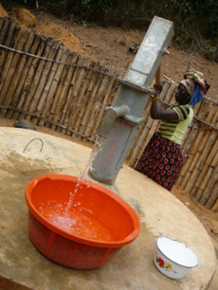
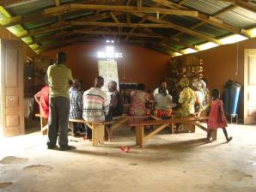
Reduction?
CSR programmes could reduce women’s time- burden
E.g. Philanthropic projects like wells in
appropriate places.
Time-cutting equipment for farming.
Childcare facilities, flexible working practices.
However, programmes can also exacerbate the time-burden:
In Ghana, women’s time was put under further stress by micro-enterprise training and development.
Stakeholder engagement and Participatory workshops are great- but they impede on women’s already stretched time and resources.

Slide 9
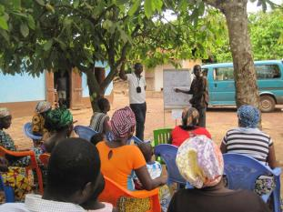
Redistribution?
Possibly the hardest part…
how to encourage men, companies
& states to shoulder some of the work?
The continued push for women into ‘alternative’ work perpetuated gendered power relations between women and men as ‘non-farmers’ and ‘farmers’. Women were pushed back into roles as wives, mothers, helpers, on the farmstead.
However, training, as well as participatory workshops that include an element of gender sensitisation offer hope for a beginning to lift women's voices and awareness of both genders of women's triple shift (Said-Allsopp and Tallontire, 2015).

Slide 10
Conclusion
Unpaid care work is not just a Global South problem.
CSR goes beyond the 9-5
CSR goes beyond office walls
Unpaid care roles may impact on CSR practices and how successful they may be.
CSR practices may impact upon unpaid care roles- in both positive and negative ways.
This means thinking about the other roles employees and value chain workers must play to take proactive steps to recognise, reduce and redistribute the unpaid work burden.
Unlikely though corporate will alone- the success stories include partnerships (e.g. The Body Shop).

Slide 11
Thank you !
Comments, suggestions?
References & paper available at lmc.ikl@cbs.dk

