Slide 1
DI Dansk Industri and
Industriens Fond
Experiences of Danish Medium-size firms
2015 – Ready for Africa?
2016 - 2018 – Project Africanisation

Slide 2
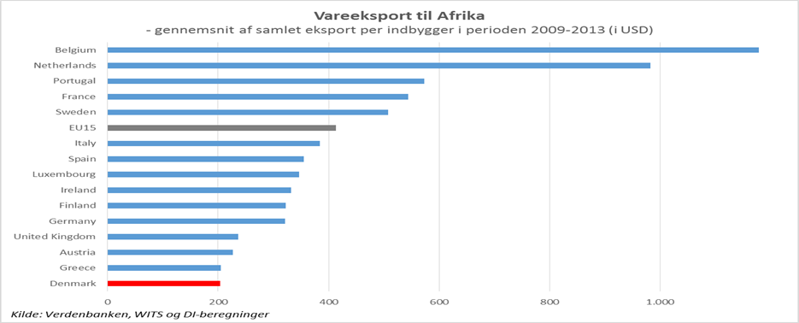
2015 – Ready for Africa?
Average EU15 performance would increase Danish exports to Africa with approx. USD 1 billion

Slide 3
Projects 2015 and 2016
Ready for Africa 2015
Africanisation 2016 - 2018
Based on 50 questionnaires and 15 interviews – in 2015
Preparation
Bootcamp
Implement

Slide 4
Project Africanisation – participants
14 Danish firms:
8 with experience in doing business in developing countries
5 with African experience
4 with Kenyan experience

Slide 5
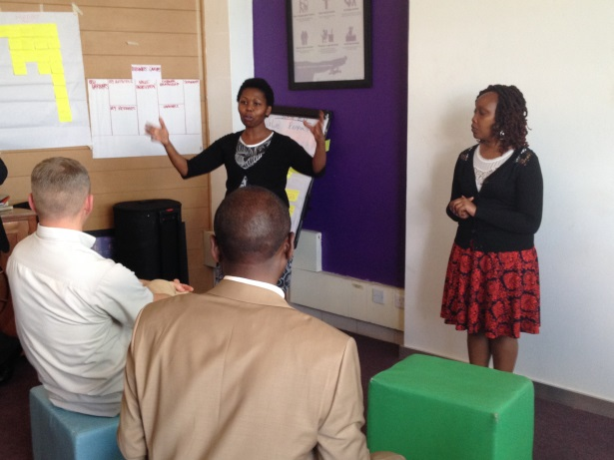
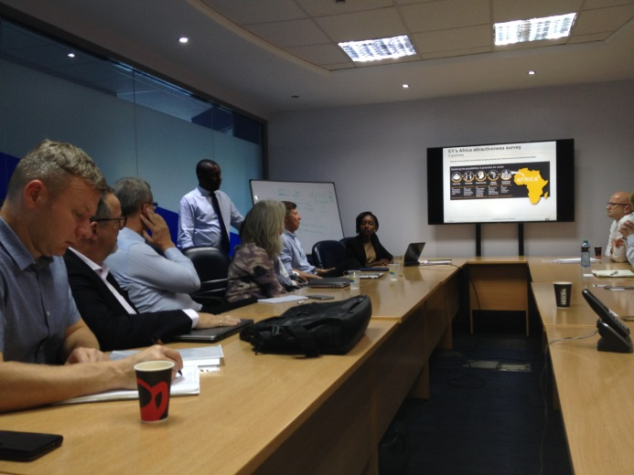
Project Africanisation – preparation and Bootcamp in Nairobi
2 workshops held in Denmark
1 seminar on business partner selection
2 Kenyan DI business development consultants hired
Visit to all participating firms in Denmark
Bootcamp – 1 week in Nairobi
General information about doing business in Kenya
Kenya Association of Manufacturing – key role
Meetings with Kenyan business partners
Follow-up meeting held in Denmark

Slide 6
Before the Bootcamp in Nairobi

Slide 7
After the Bootcamp in Nairobi

Slide 8
After the Bootcamp in Nairobi

Slide 9
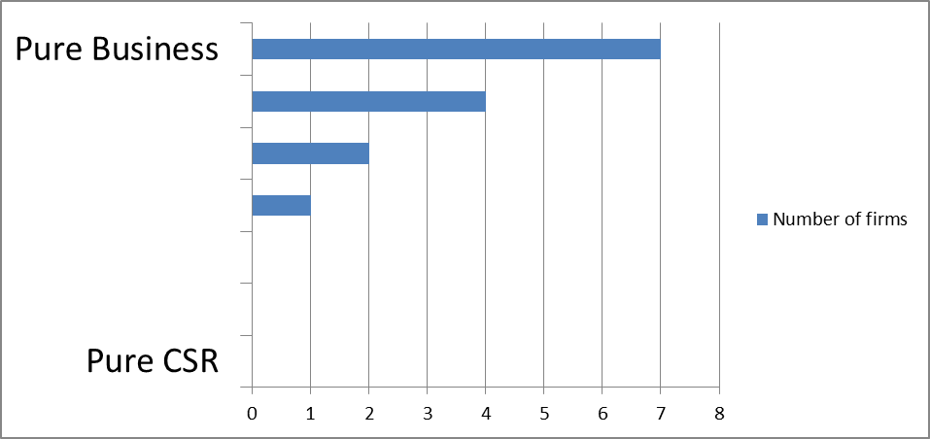
After the Bootcamp in Nairobi

Slide 10
Thank you
and
Questions

